Slide 1

Environmental & Health Monitoring System

Slide 2
ABSTRACT
Aims to track and analyze various environmental factors, such as air and water quality, and temperature, across different locations.
By collecting data from sensors, the project provides insights into pollution levels, correlates them with health outcomes, and generates alerts for critical conditions.
This system helps in making informed decisions to protect public health and the environment.

Slide 3
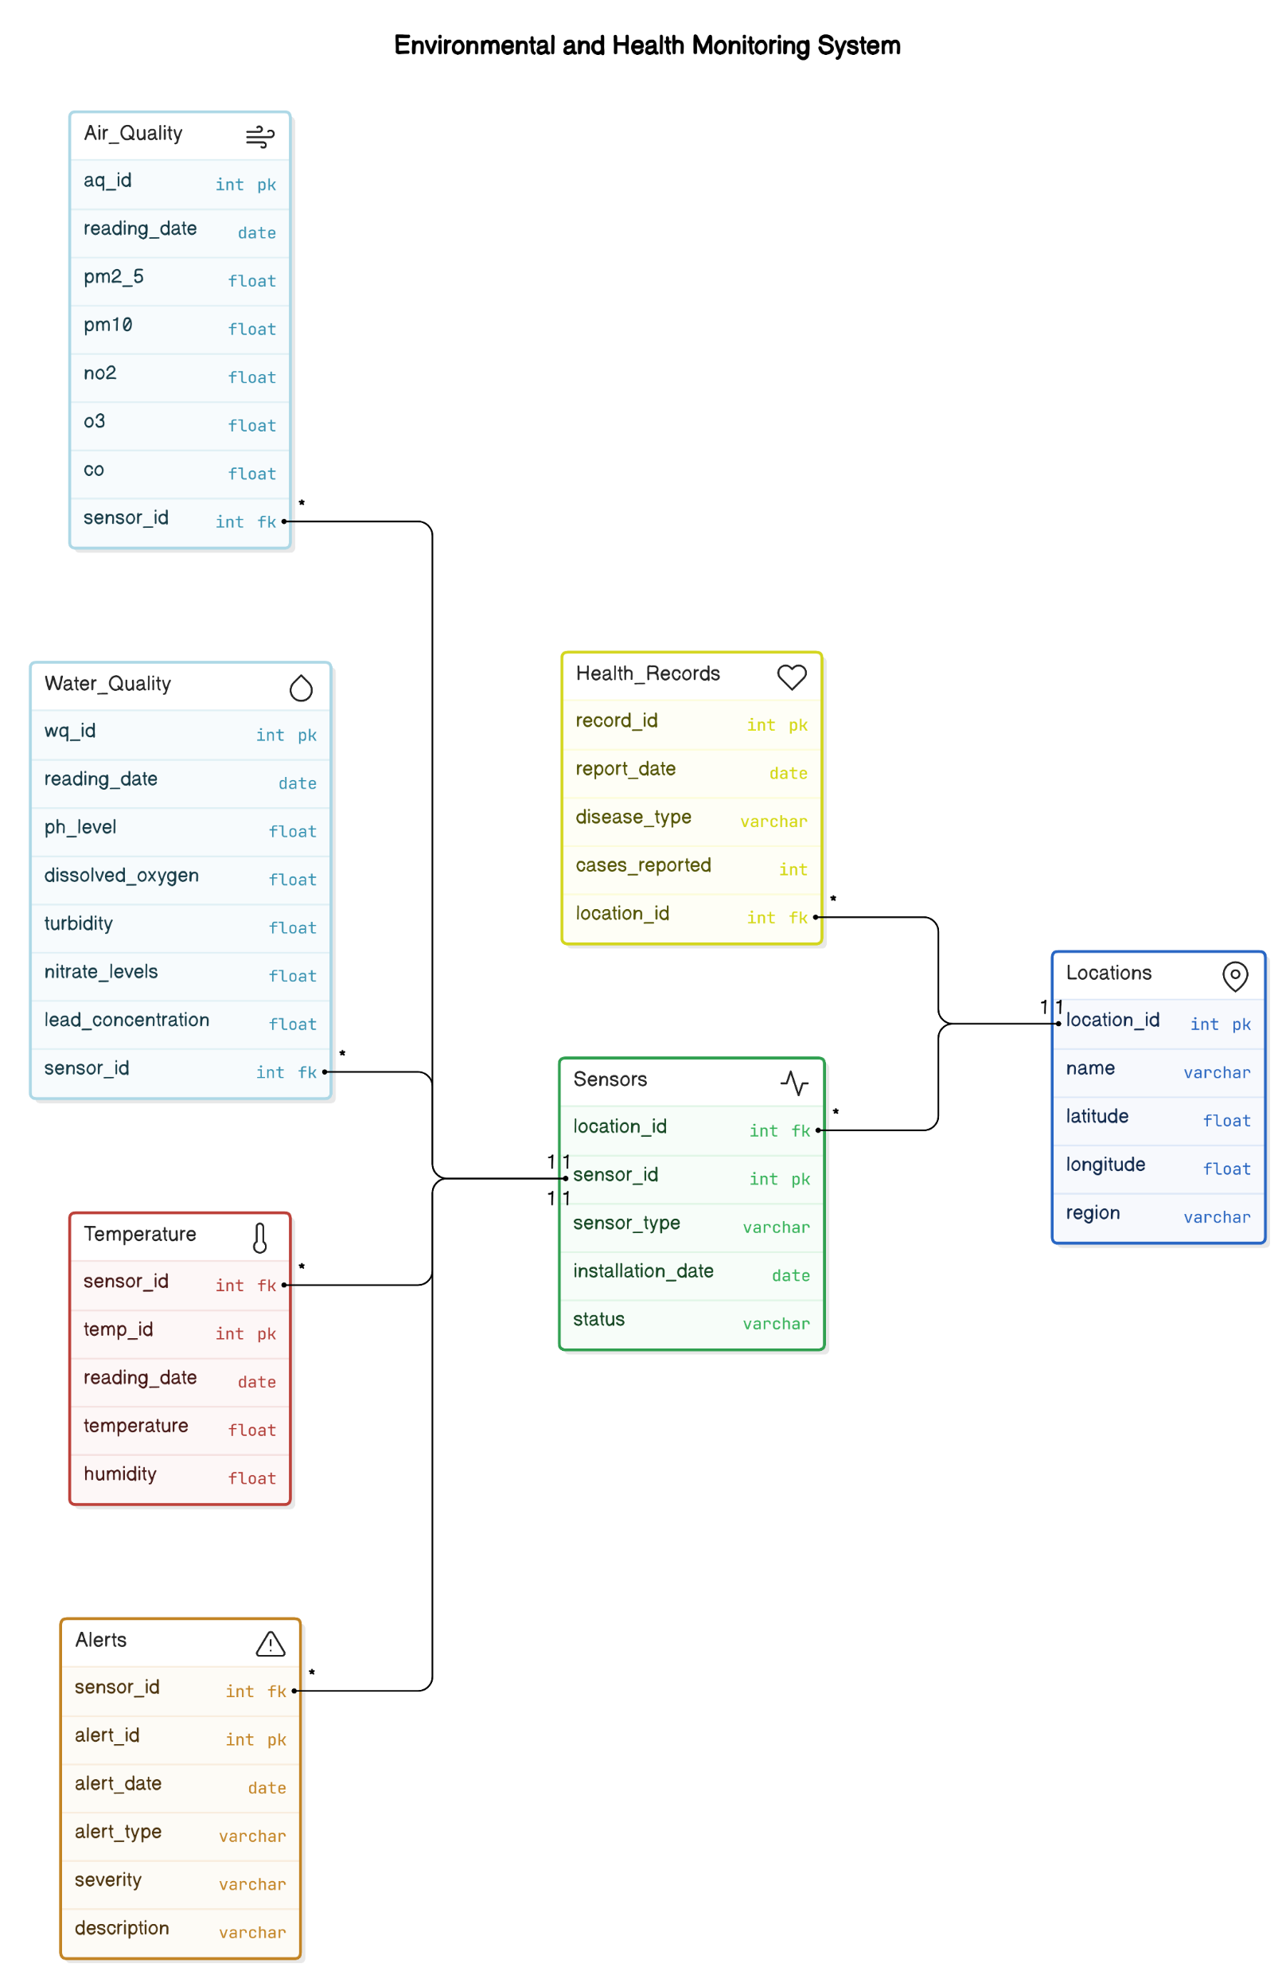
ER-DIAGRAM

Slide 4
STRUCTURE OF THE TABLES

Slide 5
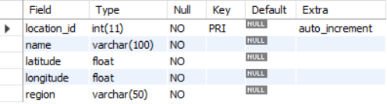
Locations Table
This table shows
different locations
with regions.
Syntax:
DESC Locations;

Slide 6
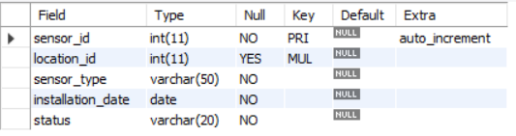
Sensors Table
This table shows
different sensors
installed at various
locations.
Syntax:
DESC Sensors;

Slide 7
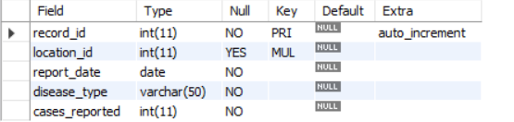
Health_Records Table
This table displays
various health issues
and its cases.
Syntax:
DESC Health_Records;

Slide 8
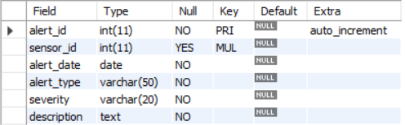
Alerts Table
This table displays
different environmental
alerts with severity.
Syntax:
DESC Alerts;

Slide 9
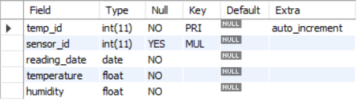
Temperature Table
This table shows
temperature and
humidity.
Syntax:
DESC Temperature;

Slide 10
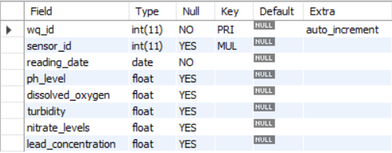
Water_Quality Table:
This table shows water
quality based on various
factors.
Syntax:
DESC Water_Quality;

Slide 11
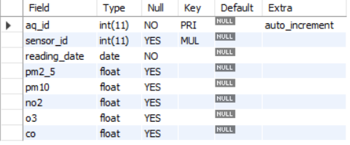
Air_Quality Table:
This table displays
air quality based on
different factors.
Syntax:
DESC Air_Quality;

Slide 12
CONTENTS OF THE TABLE

Slide 13
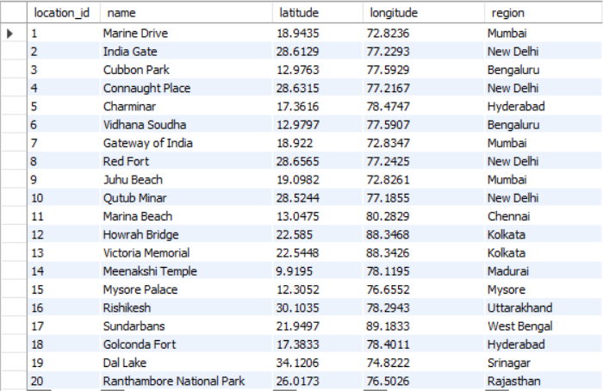
Locations
select * from Locations;

Slide 14
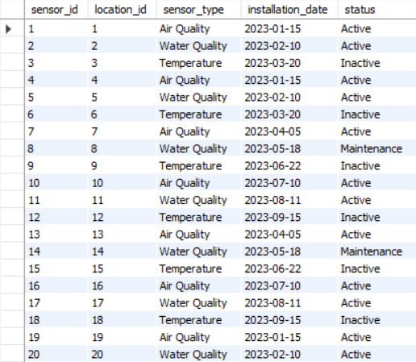
Sensors
select * from Sensors;

Slide 15
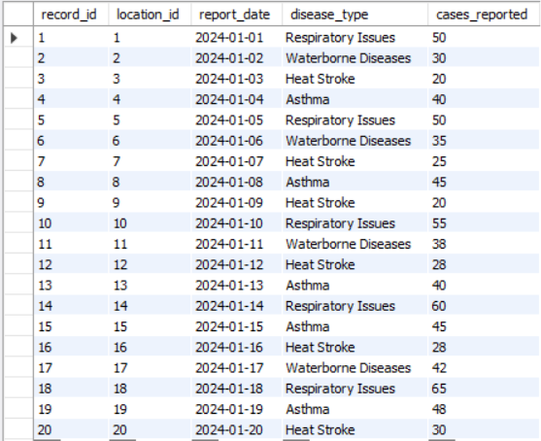
Health_Records
select*from Health_Records;

Slide 16
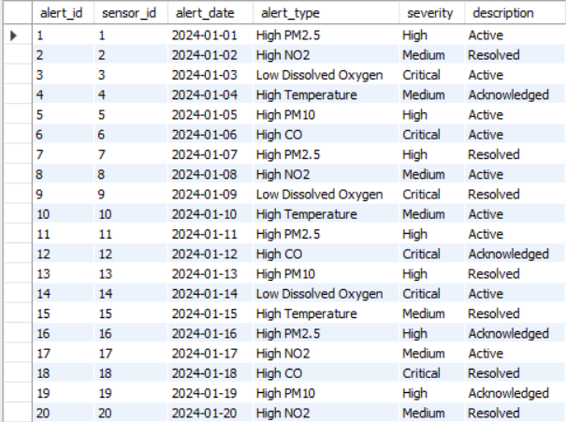
Alerts
select * from Alerts;

Slide 17
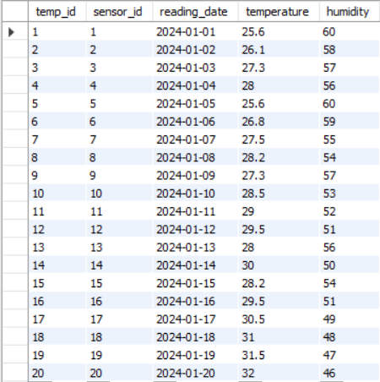
Temperature
select * from Temperature;

Slide 18
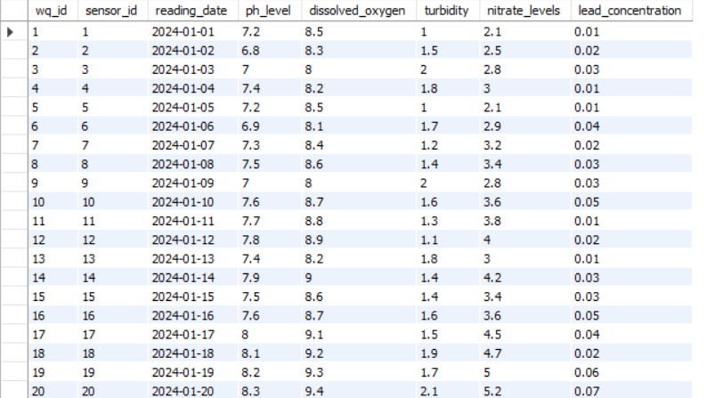
Water_Quality
select * from Water_Quality;

Slide 19
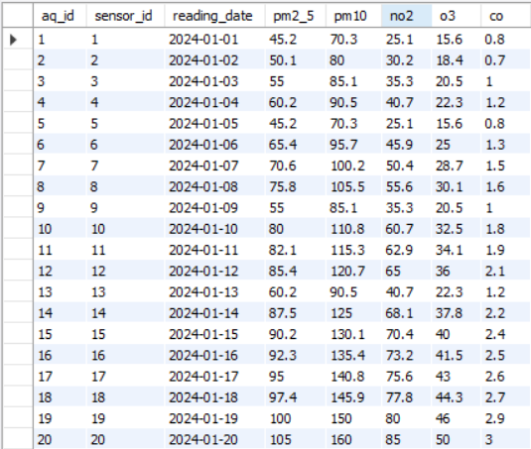
Air_Quality
select * from Air_Quality;

Slide 20
SUB- QUERIES

Slide 21
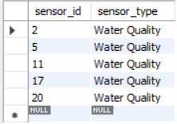
Find all the sensors which measures water quality and status is active.
SELECT sensor_id, sensor_type FROM Sensors WHERE status = 'Active’ AND sensor_id IN
(SELECT sensor_id FROM Sensors
WHERE sensor_type = 'Water Quality’);

Slide 22
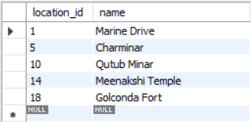
Display all the locations where cases of respiratory issues reported.
SELECT location_id, name FROM Locations WHERE location_id IN
(SELECT location_id FROM Health_Records
WHERE disease_type = 'Respiratory Issues’);

Slide 23

Display Name of the locations where No. of Asthma cases >40.
SELECT name, region FROM Locations WHERE location_id IN
(SELECT location_id FROM Health_Records WHERE
disease_type='Asthma' AND cases_reported>40);

Slide 24
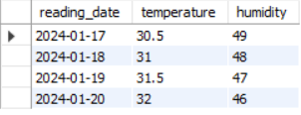
Show the reading dates where temperature>30 and humidity is>40
SELECT reading_date, temperature, humidity FROM Temperature
WHERE sensor_id
IN (SELECT temp_id WHERE temperature>30 AND humidity>40);

Slide 25
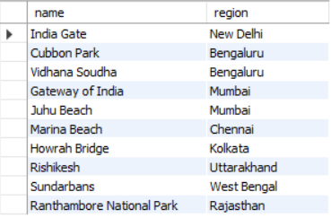
Display the locations where either Heat stroke or Waterborne diseases reported.
SELECT name, region FROM locations WHERE location_id IN
(SELECT location_id FROM Health_Records WHERE disease_type= 'Heat Stroke’
OR
disease_type='Waterborne Diseases’);

Slide 26
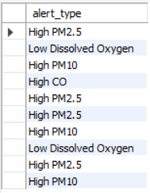
Display Alerts whose severity is either high or critical and is currently active
SELECT alert_type FROM alerts WHERE sensor_id IN
(SELECT alert_id WHERE severity='High' OR severity='Critical' AND description='Active’);

Slide 27
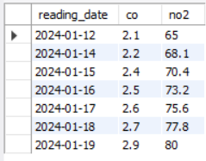
Find dates where co emission > 2 and no2 emission between 65 and 80.
SELECT reading_date,co,no2 FROM Air_Quality WHERE sensor_id IN
(SELECT aq_id WHERE co>2 AND no2 BETWEEN 65 AND 80);

Slide 28
JOINS

Slide 29
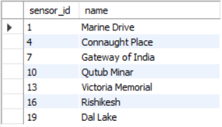
Find the locations where sensors detect air quality and are active.
SELECT sensor_id IN, l.name FROM Sensors s
JOIN Locations l ON s.location_id = l.location_id
WHERE s.sensor_type = 'Air Quality’ AND s.status = 'Active’;

Slide 30
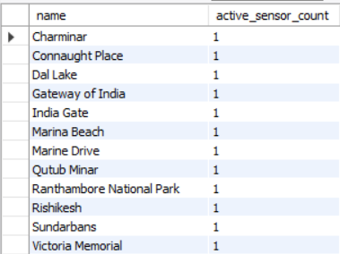
Retrieve the location names and the count of active sensors installed at each location.
SELECT l.name, COUNT(s.sensor_id) AS active_sensor_count
FROM Locations l JOIN Sensors s ON l.location_id = s.location_id WHERE s.status = 'Active’
GROUP BY l.name;

Slide 31
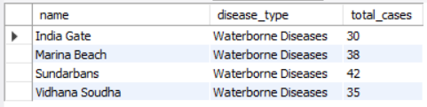
Display location name where cases of waterborne diseases reported with number of cases.
SELECT l.name, hr.disease_type, SUM(hr.cases_reported) AS total_cases
FROM locations l
LEFT JOIN health_records hr ON l.location_id = hr.location_id
WHERE
hr.disease_type='Waterborne Diseases’ GROUP BY
l.name, hr.disease_type;

Slide 32
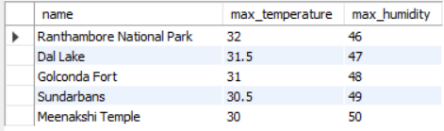
Retrieve top 5 locations with high temperature and its corresponding humidity.
SELECT l.name, MAX(t.temperature)
AS max_temperature,
MAX(t.humidity) AS max_humidity
FROM locations l
LEFT JOIN sensors s ON l.location_id = s.location_id
LEFT JOIN temperature t ON s.sensor_id = t.sensor_id
GROUP BY l.name
ORDER BY max_temperature DESC
LIMIT 5;

Slide 33
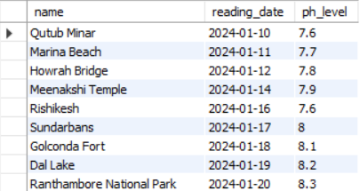
Display locations with ph level above 7.5
SELECT l.name, wq.reading_date, wq.ph_level
FROM water_quality wq
RIGHT JOIN locations l ON wq.sensor_id = l.location_id
WHERE
ph_level>7.5;

Slide 34
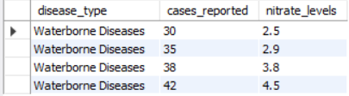
Show No. of cases and nitrate level when disease type is waterborne diseases.
SELECT hr.disease_type, hr.cases_reported, wq.nitrate_levels
FROM water_quality wq
RIGHT JOIN health_records hr
ON
wq.sensor_id = hr.location_id WHERE
disease_type='Waterborne Diseases';

Slide 35
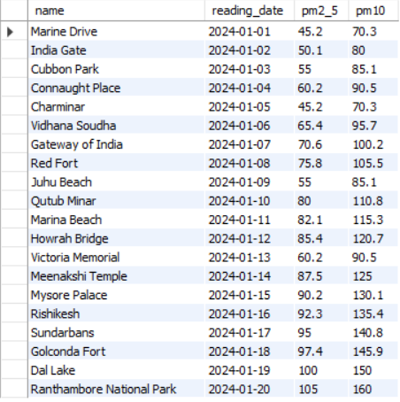
Display all locations with their pm2.5 and pm10 readings.
SELECT l.name, aq.reading_date, aq.pm2_5, aq.pm10
FROM air_quality aq
RIGHT JOIN locations l
ON
aq.sensor_id = l.location_id;

Slide 36
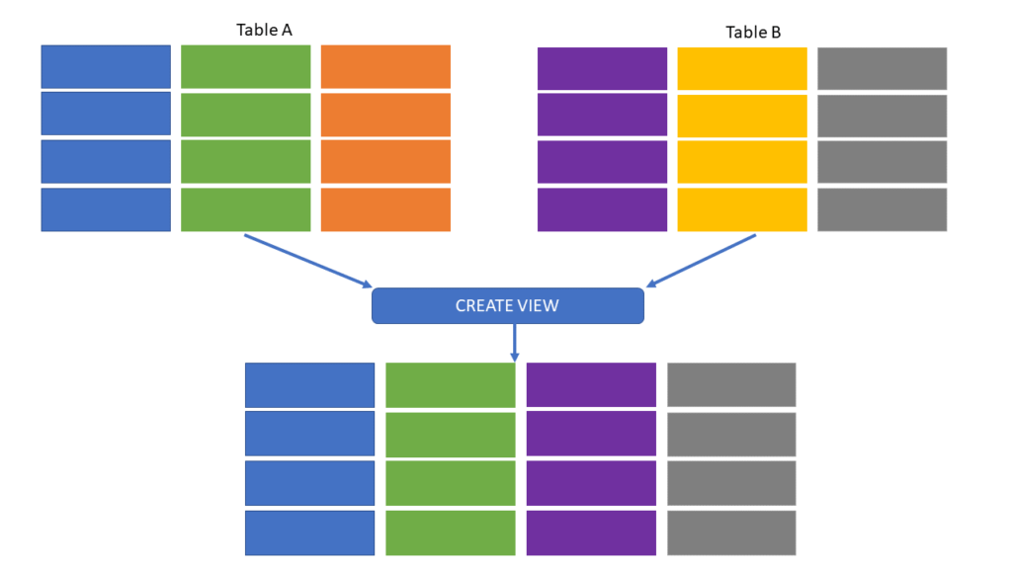
VIEWS IN MYSQL

Slide 37
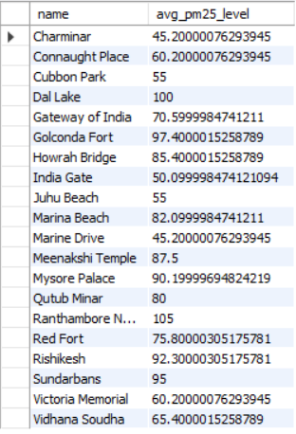
Create a View to display average pm 2.5 level of all locations .
CREATE VIEW View_AirQualityByLocation AS
SELECT l.name, AVG(a.pm2_5) AS avg_pm25_level
FROM Locations l
JOIN Sensors s ON l.location_id = s.location_id
JOIN Air_Quality a
ON
s.sensor_id = a.sensor_id
GROUP BY l.name;
SELECT * from View_AirQualityByLocation;

Slide 38
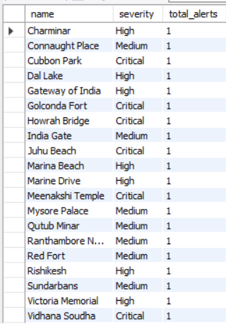
Create a view that shows the total number of alerts by severity level for each location.
CREATE VIEW View_AlertsByLocation AS
SELECT l.name, a.severity, COUNT(a.alert_id) AS total_alerts
FROM Locations l
JOIN Sensors s ON l.location_id = s.location_id
JOIN Alerts a ON s.sensor_id = a.sensor_id
GROUP BY l.name, a.severity;
select * from View_AlertsByLocation;

Slide 39

Prepared By
ASHUTOSH SANTOSH RANE
T324/DS&DA/July2024/1-3pm/PS/R/Data Science

Slide 40
THANK YOU

